Slide 1
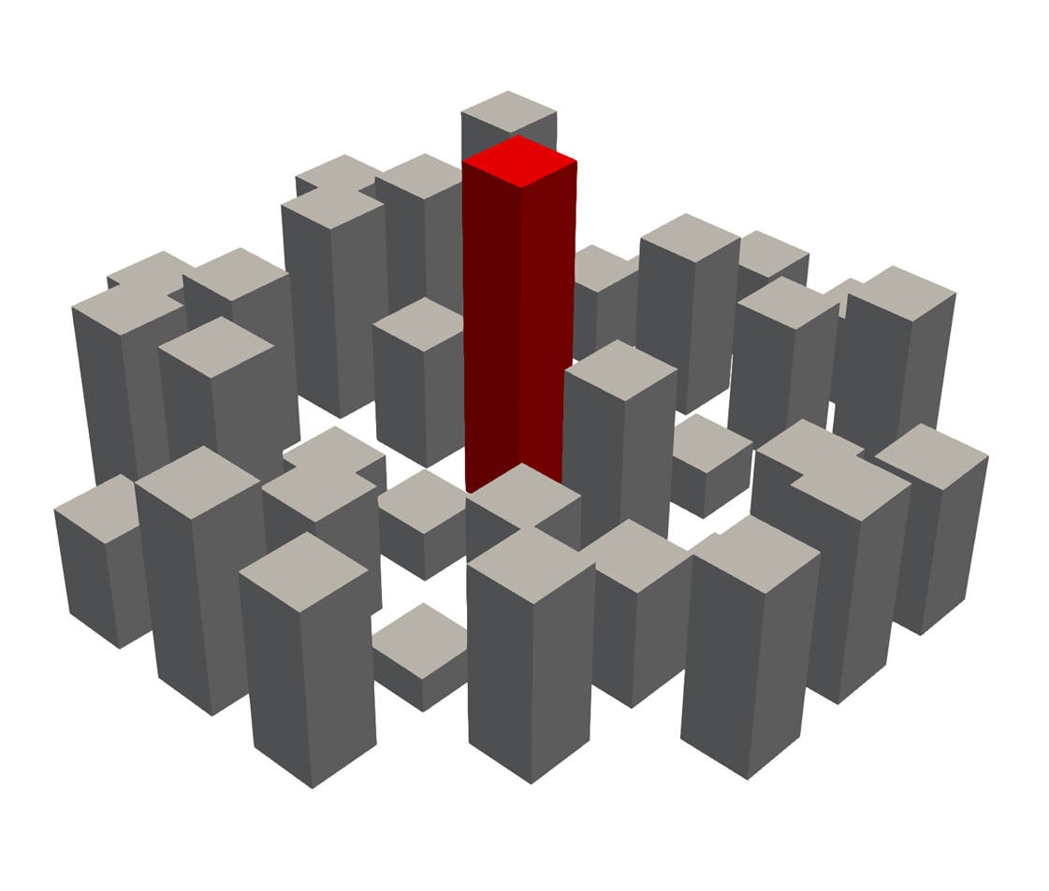
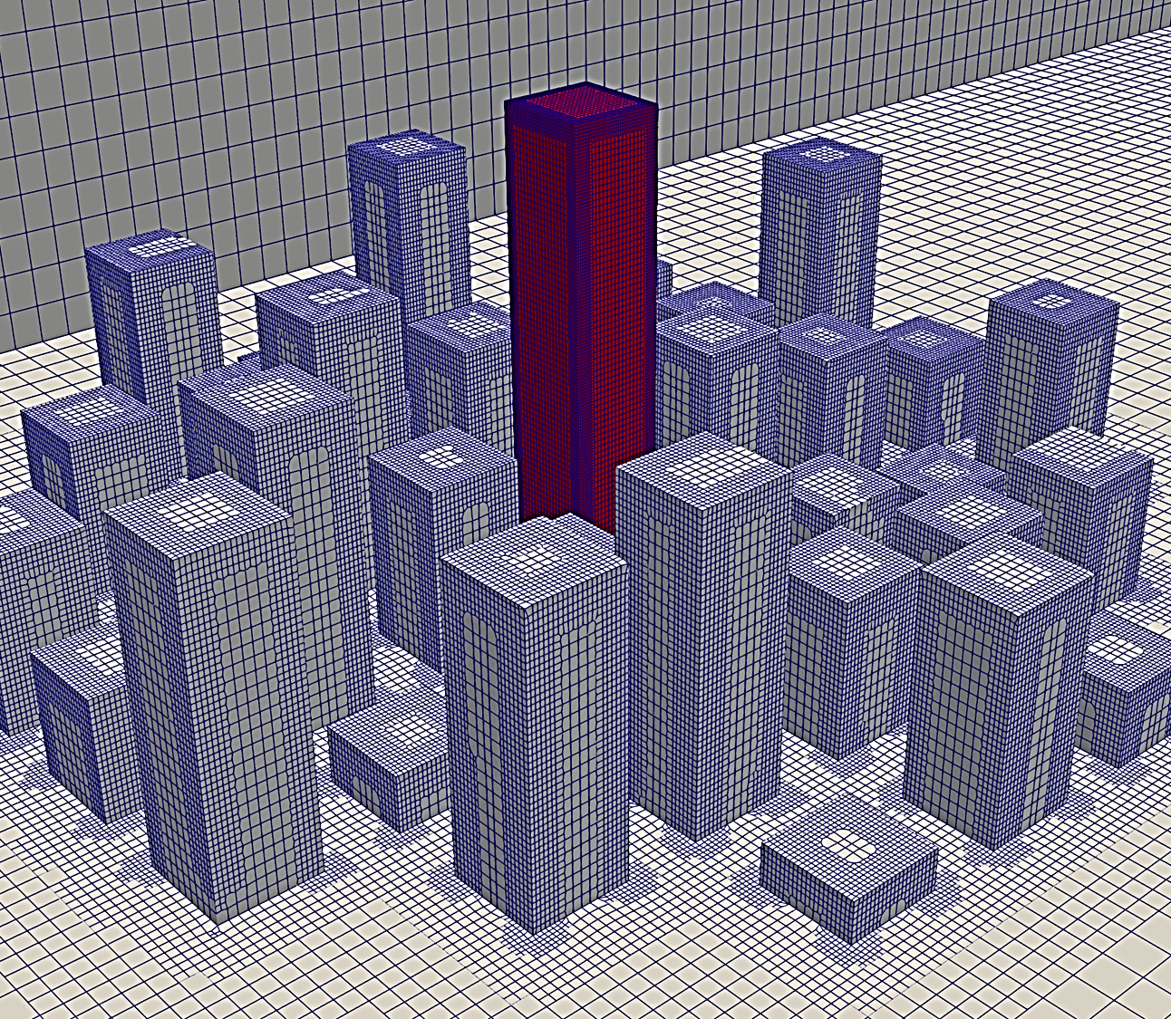
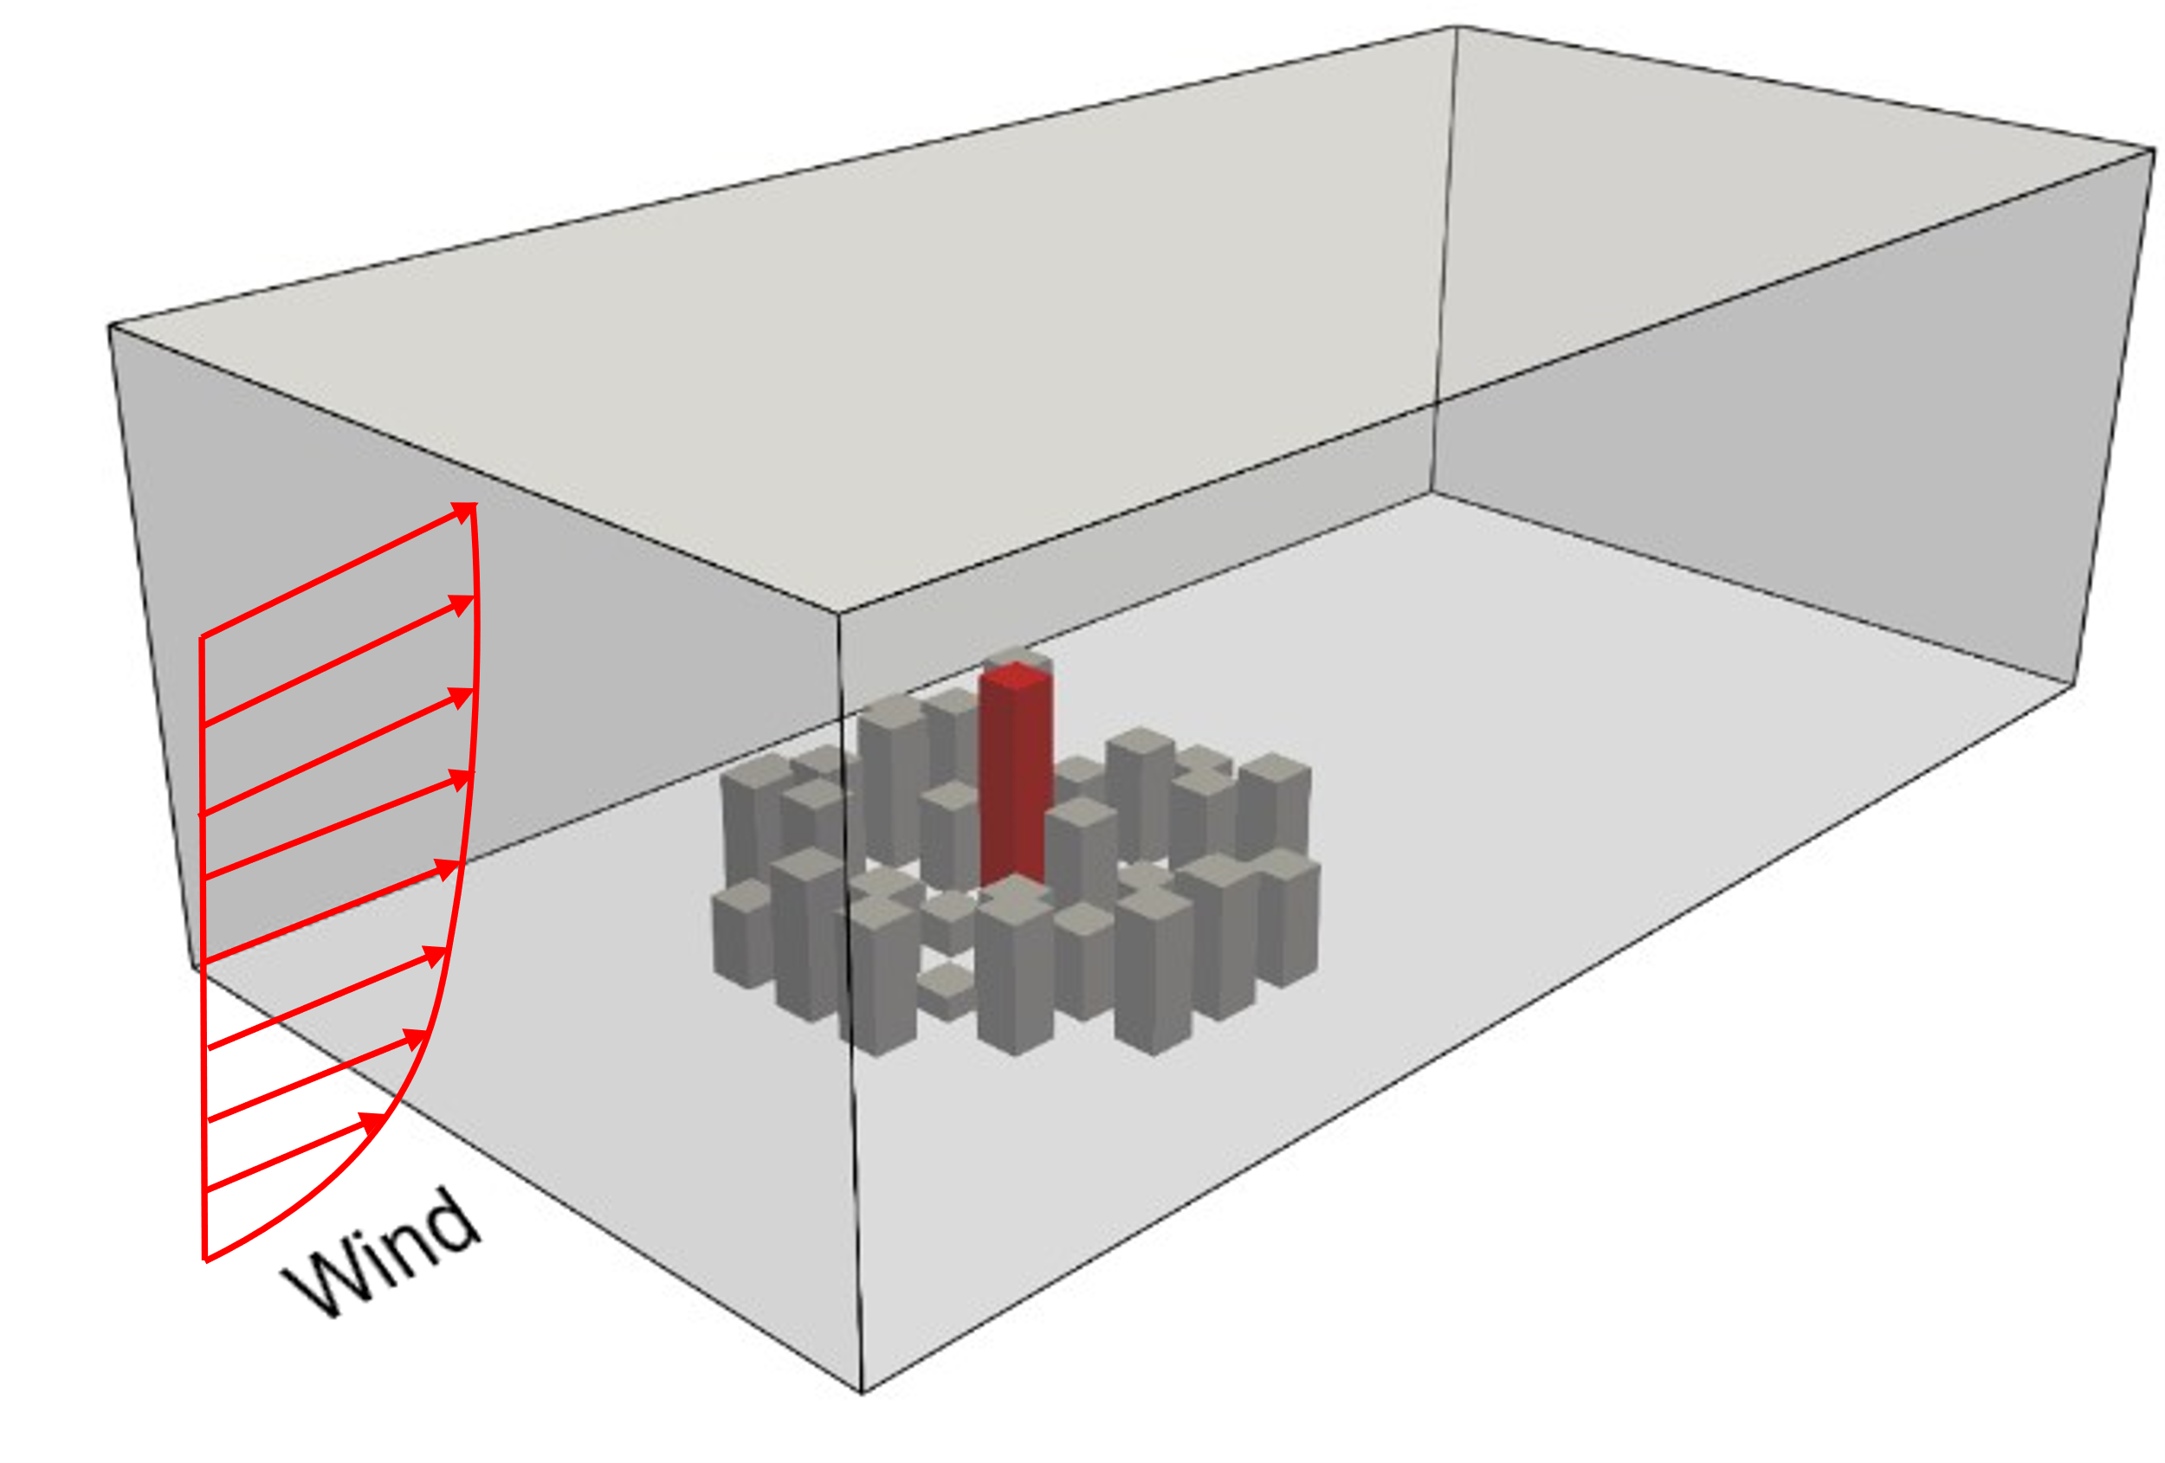
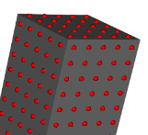
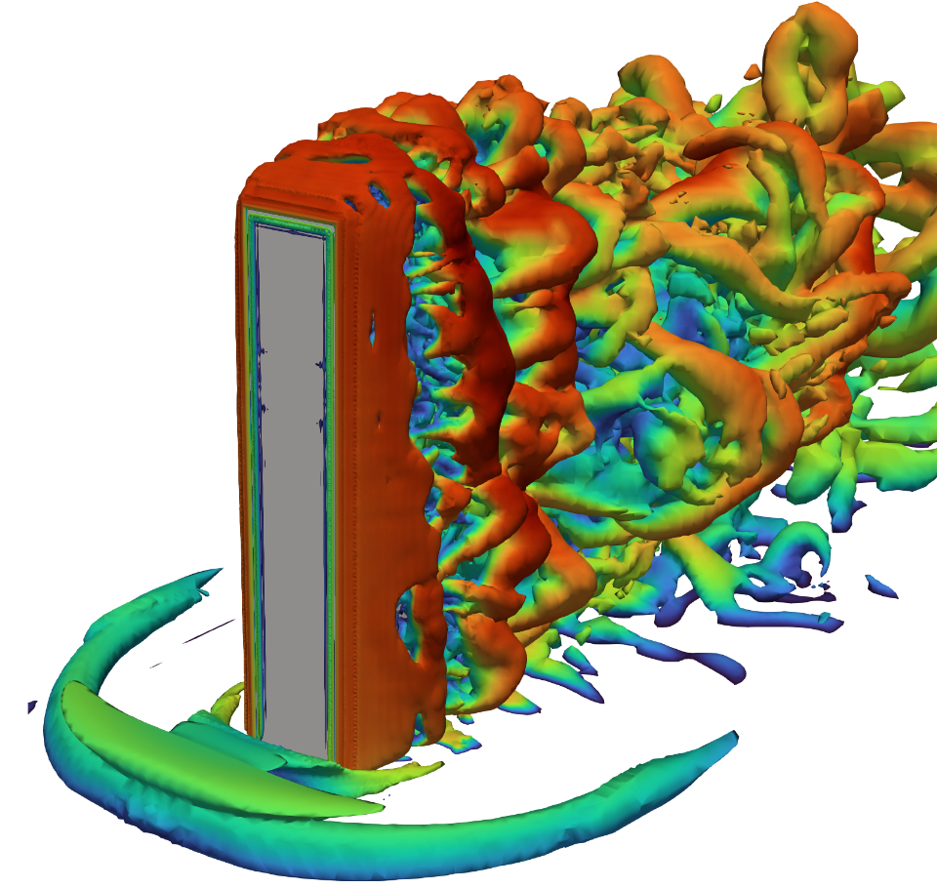


Geometry Definition
Mesh Generation
Numerical Setup
Result Monitoring
Result Analysis
Boundary Conditions
Building
Base mesh
Turbulence model
Inflow
Surface roughness
Surroundings
Refinements
Wind loads
Wind profiles
Local loads
Solver
Integrated loads
Flow field
>Turbulence model
>Solver
>Time step

